Slide 1
SENTIMENT ANALYSIS ON BRITISH AIWAYS REVIEWS
By: Abdulmalikul-mulk Abdulrahman

Slide 2
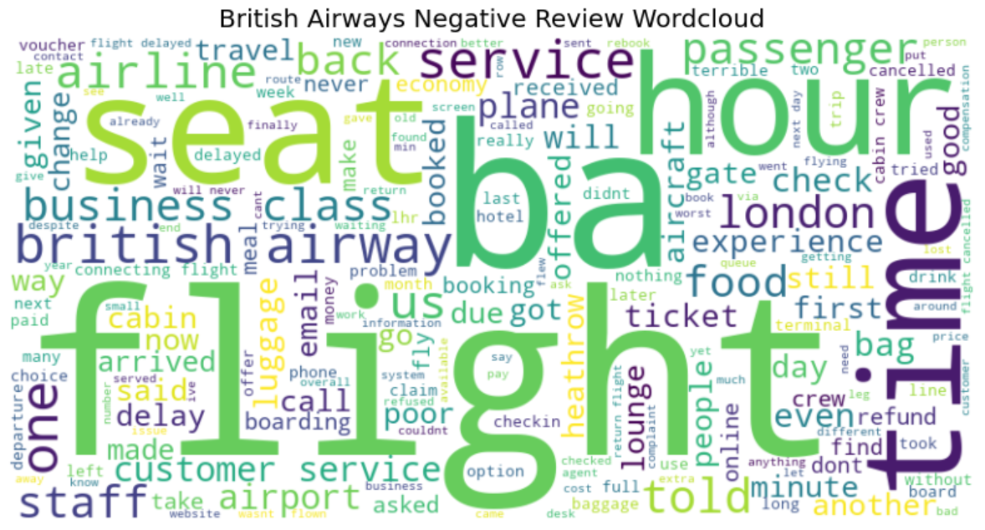
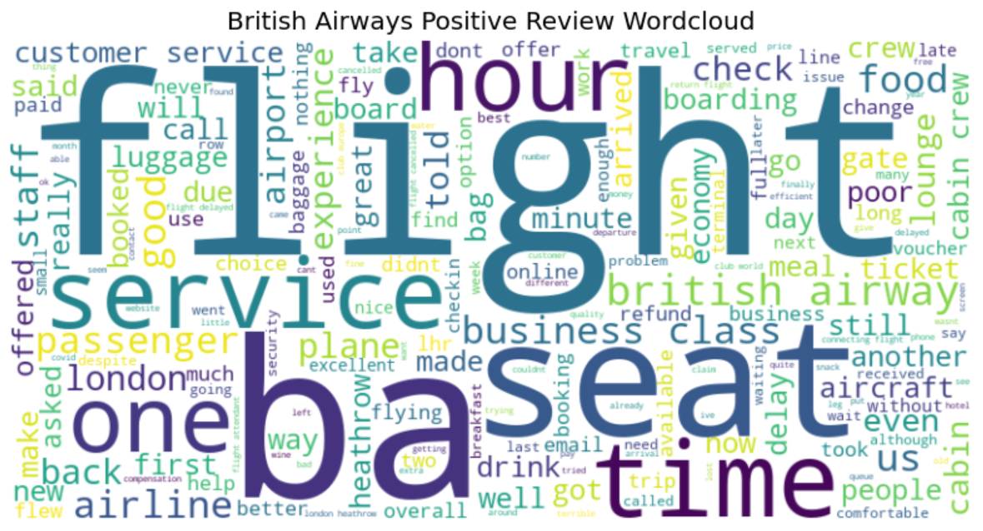
Graphical & Word cloud Summary
Negative Reviews: Dominant terms (delay, time, refund, poor, luggage, seat) reveal pain points—operational issues (delays, luggage handling), discomfort (seats), and service failures. Notably, Customer service appears in both clouds, suggesting its dual role in shaping satisfaction or frustration.
Positive Reviews: The frequent terms (Business class, airline, flight, service, crew, food, lounge) highlight key strengths—passengers appreciate premium amenities, in-flight service, and overall experience. Words like hour may indicate satisfaction even during long flights.
Key Insight: While Business class and service appear in both, positive feedback emphasizes quality and comfort, whereas negative reviews focus on reliability (delays, refunds) and comfort (seats). Addressing operational inefficiencies and service consistency could improve sentiment.
Our sentiment analysis reveals that customer feedback is predominantly negative, with 58% of reviews expressing dissatisfaction, 2% remaining neutral, and 40% reflecting a positive experience. This highlights an opportunity to address key concerns and enhance overall customer satisfaction.

